Slide 1

Adventure Game
Project Walkthrough
<p> Intro to Programming (Udacity) </p>

Slide 2
HELLO! I’m…
<p> Abed-Alfattah Sowaity </p>
<p>Session Lead / Mentor @ Udacity</p>

Slide 3
TABLE OF CONTENTS.
01
02
03
04
05
06
Project Overview & rubric
Live Demo
Game Flow & Flowchart
Key Code Walkthrough
Input Validation & Randomness
Pro Tips & Submission

Slide 4
Project Overview
<p> Build a text-based game with choice, randomness, win/lose, and replay </p>

Slide 5


Slide 6
Project Requirements & Rubric
✅ / ❌
Print narrative & choices
Validate inputs (only accept 1/2)
Use randomness for enemies.
Organize code into functions.
Follow PEP8 style (pycodestyle)

Slide 7
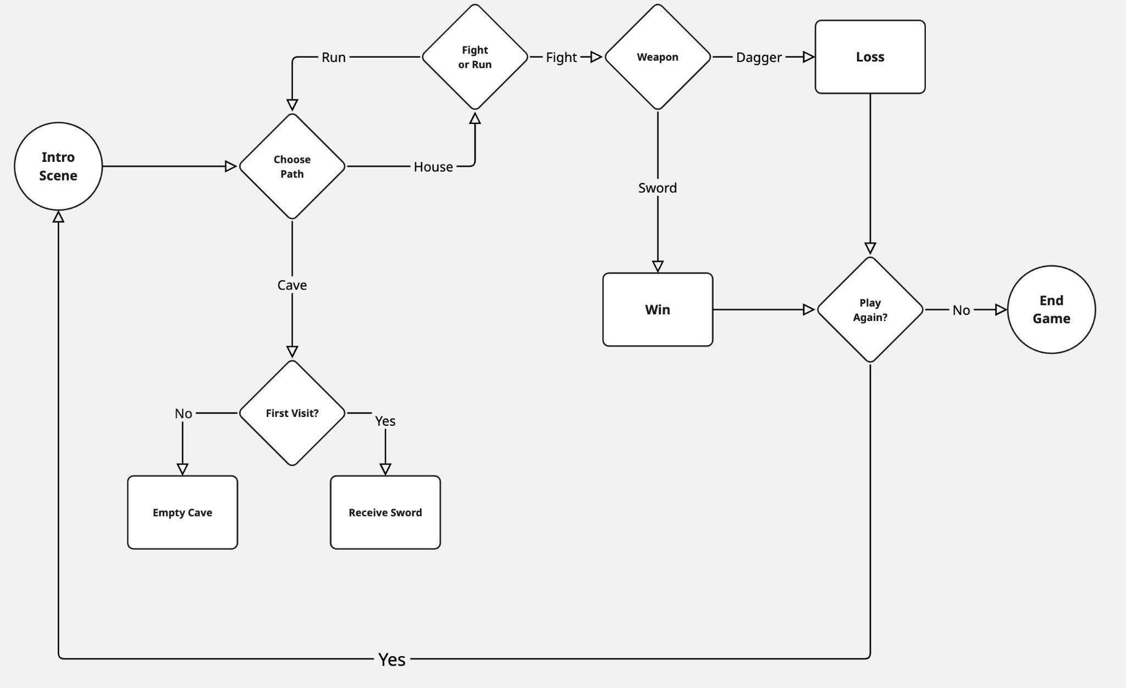
Game Flow & Flowchart

Slide 8
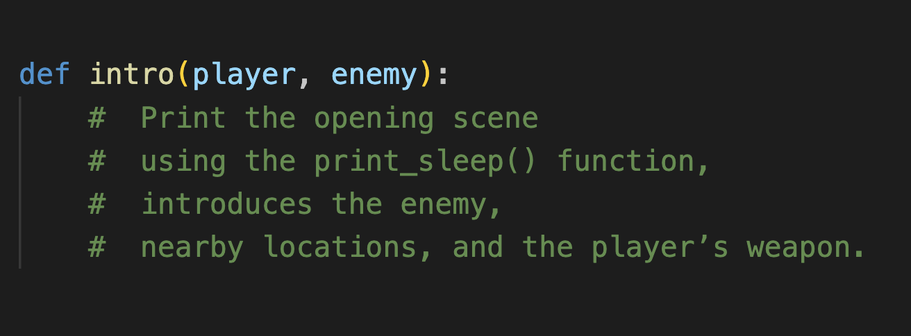
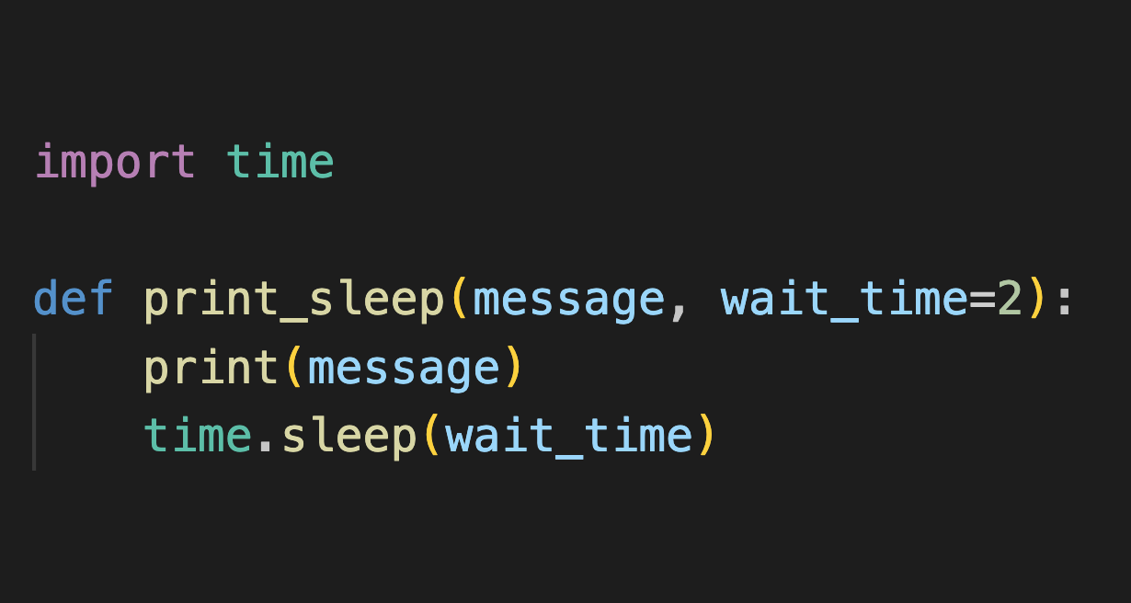
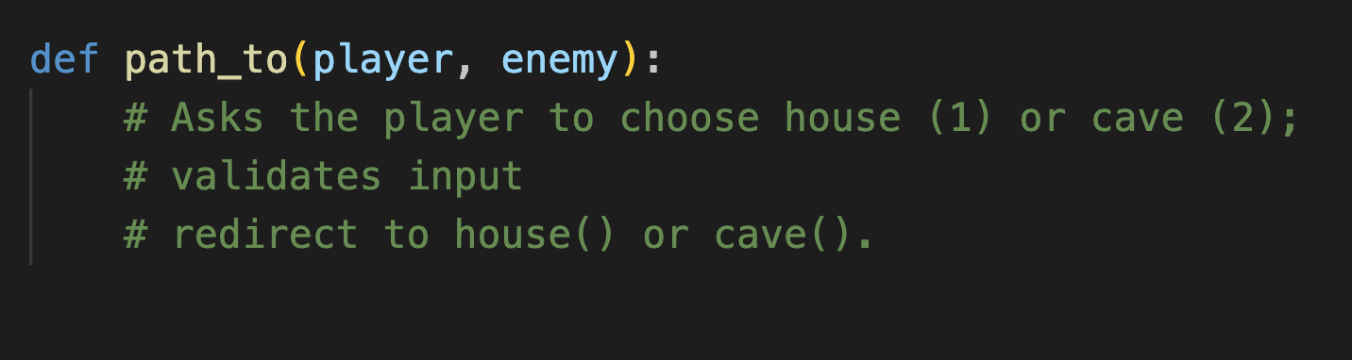
Key Code Walkthrough

Slide 9
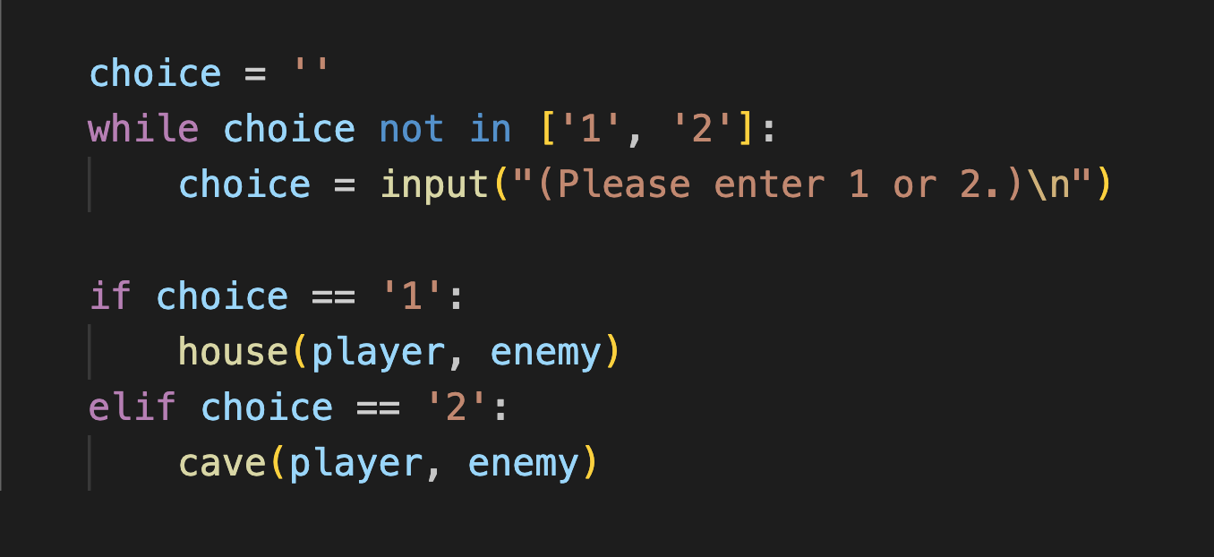
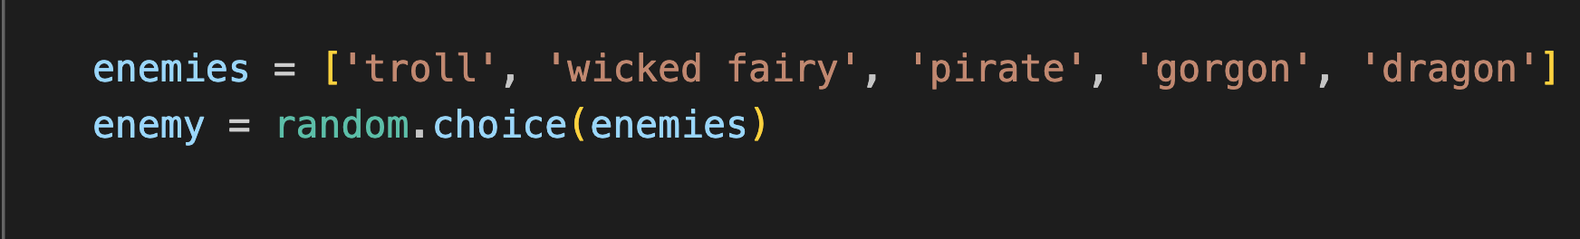
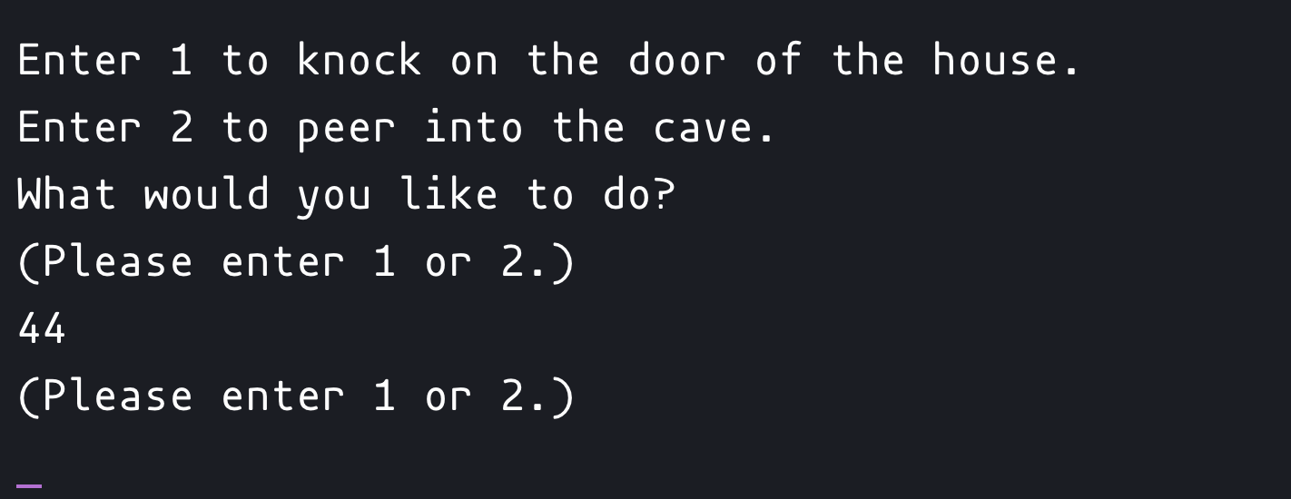
Input Validation & Randomness

Slide 10
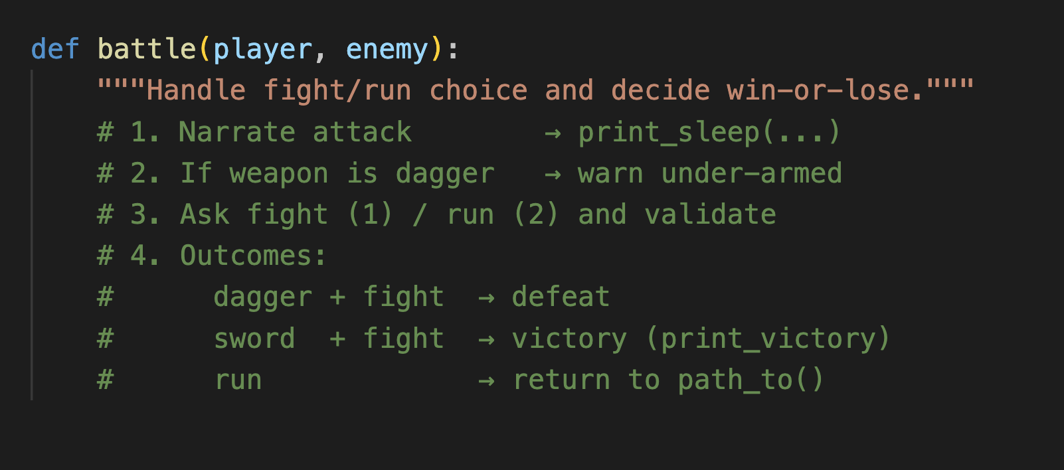
Win/Lose Mechanics

Slide 11
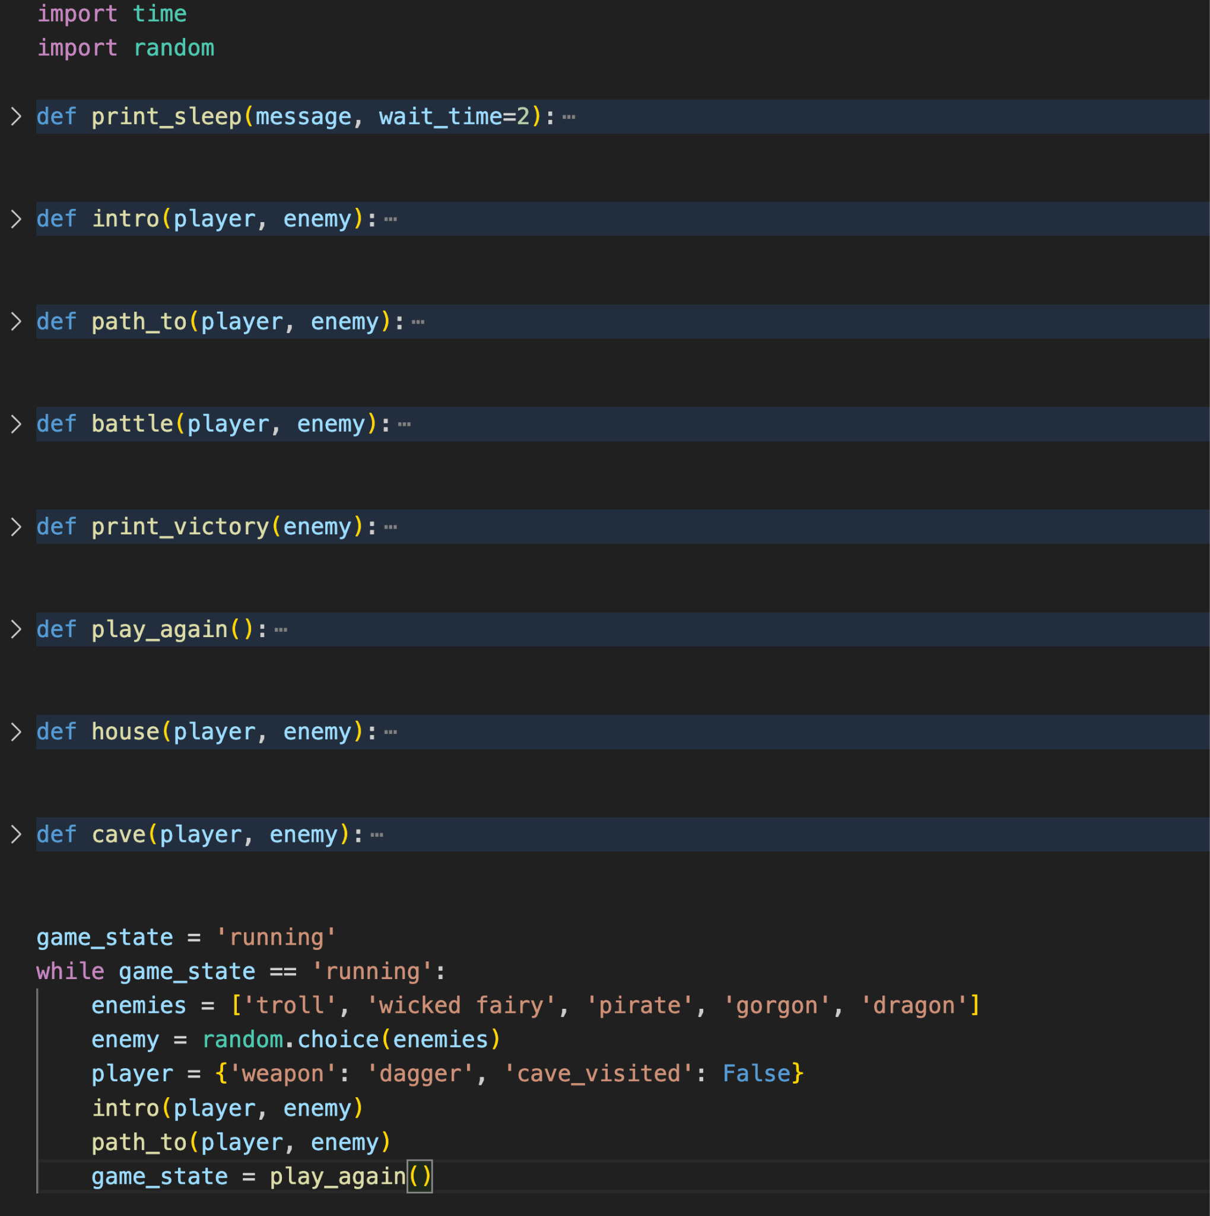
Code Structure
One function per location (house, cave, …)
Tiny helpers for shared tasks (print_sleep, battle)
Router function validates input → calls scene functions
player dict carries state everywhere
While-loop + play_again() for replay
random.choice() for enemy variety

Slide 12
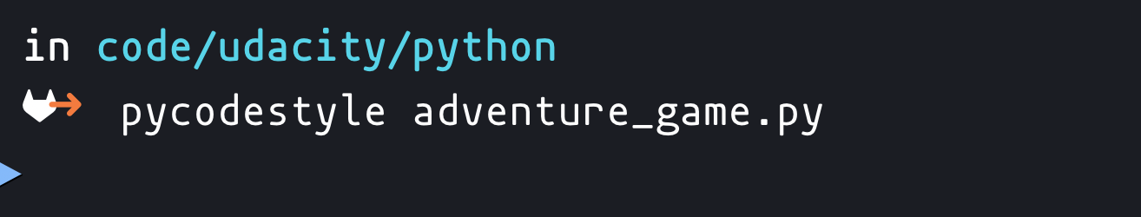
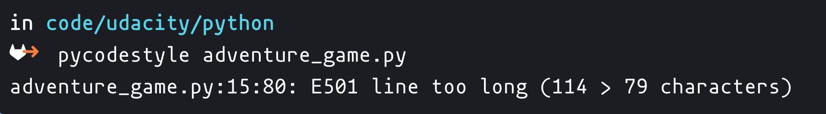
Lint & Test (Rubric: PEP 8 + Error-Free Run)
✅
❌

Slide 13
Common Reviewer Traps
❌ Global variables mutate unexpectedly
❌ Forgetting to loop on invalid input
❌ Long lines > 79 chars
❌ No randomness → identical game every run

Slide 14
Submission Checklist & Thanks
All rubric items green ✅
Code tested end-to-end ✅
adventure_game.py zipped/uploaded ✅

Slide 15
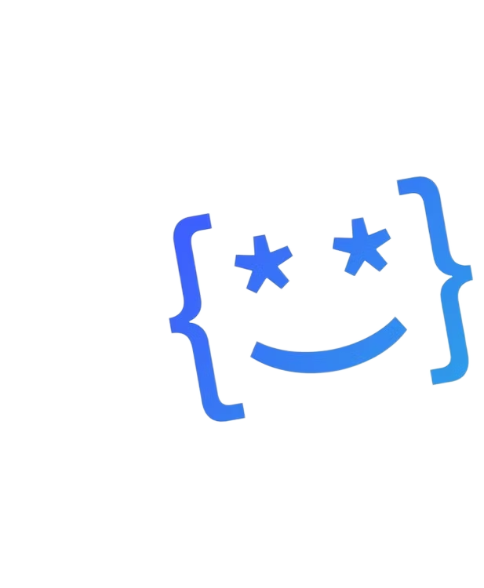
THANK YOU!
Happy Coding!

